Slide 1

Smart Stock Management System
Introduction to Smart Stock Management System: A comprehensive solution for inventory management that integrates supplier and customer modules into a single database.
This system is designed to streamline the process of inventory management, making it more efficient and accurate. It allows for real-time tracking of stock levels, automated purchase and sales orders, and seamless payment processing.
Nitish Srivastava
19/04/2024

Slide 2
Supplier Module
Overview of the Supplier Module: This module allows suppliers to manage their inventory, create sales orders, and process payments.
The supplier module is designed to provide suppliers with a comprehensive overview of their stock levels, enabling them to make informed decisions about restocking and sales.
Key Features
Supplier registration and management
Purchase order creation
Stock monitoring and updates
Payment management

Slide 3
Customer Module
Overview of the Customer Module: This module allows customers to place orders, track their order status, and make payments.
The customer module provides a user-friendly interface for customers to manage their orders and payments, enhancing the overall customer experience.
Customer registration and management
Sales order creation
Stock availability check
Payment processing
Key Features

Slide 4
Integrated Database
The Power of a Unified Database: Both the supplier and customer modules access a single, integrated database.
This unified database ensures data consistency and accuracy, eliminating the risk of data duplication or discrepancies between the supplier and customer modules.

Slide 5
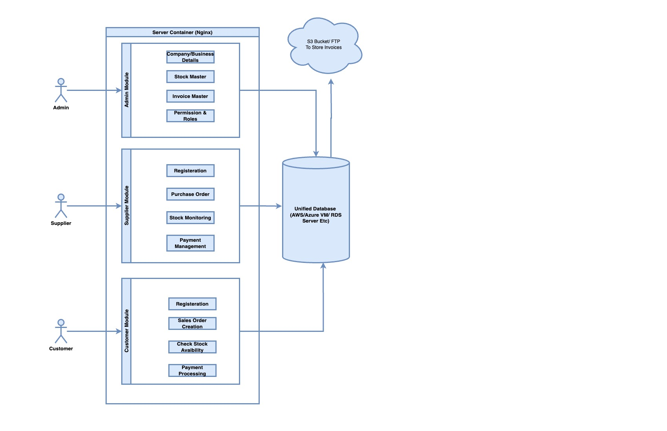
System Architecture

Slide 6
Real-Time Stock Tracking
Real-Time Stock Tracking: The system provides real-time updates on stock levels, ensuring accurate inventory management.
This feature allows both suppliers and customers to have up-to-date information on stock availability, reducing the risk of stockouts or overstocking.

Slide 7
Automated Purchase and Sales Orders
Automated Purchase and Sales Orders: The system automates the creation of purchase and sales orders, saving time and reducing errors.
This automation not only streamlines the order process but also ensures accuracy, as the system automatically generates orders based on real-time stock levels.

Slide 8
Seamless Payment Processing
Seamless Payment Processing: The system facilitates easy and secure payment processing for both suppliers and customers.
This feature simplifies the payment process, ensuring timely payments and improving cash flow management.

Slide 9
Stock Logs
Stock Logs: The system maintains detailed stock logs, providing a historical record of stock movements.
These logs can be used for auditing purposes, to identify trends, and to make informed decisions about future stock management.

Slide 10
Case Study
Case Study 1: A large retail company implemented the Smart Stock Management System and saw a 20% reduction in stockouts within the first six months.
Case Study 2: A small online store used the system to automate their order and payment processes, saving them several hours of manual work each week.

Slide 11
Conclusion
The Smart Stock Management System is a comprehensive solution for inventory management, integrating supplier and customer modules into a single, unified database.
With features like real-time stock tracking, automated orders, seamless payment processing, and detailed stock logs, this system can significantly improve the efficiency and accuracy of inventory management.

